Slide 1
How to create an instance in aws

Slide 2
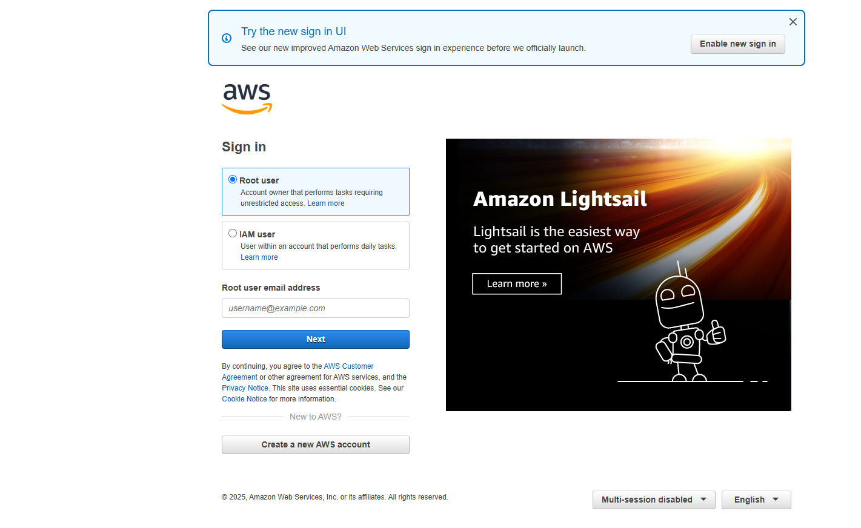
Step 1: Log in to AWS Console 1. Go to AWS Management Console 2. Sign in to your account.

Slide 3
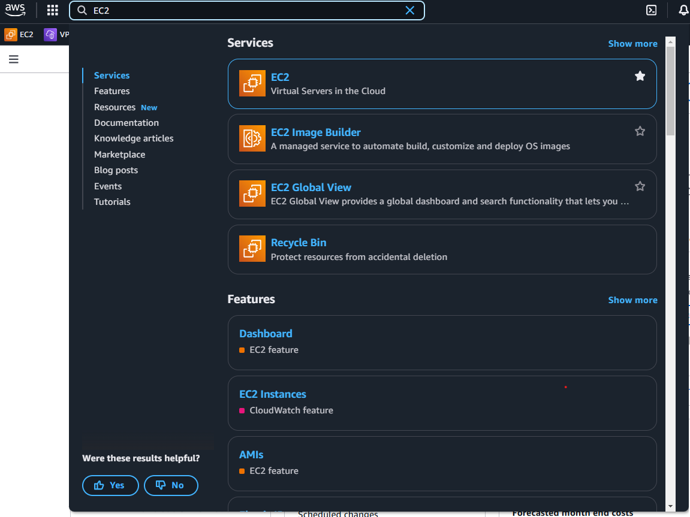
Step 2: Open EC2 Dashboard 1. Search for EC2 in the AWS console search bar. 2. Click on EC2 to open the EC2 dashboard.

Slide 4
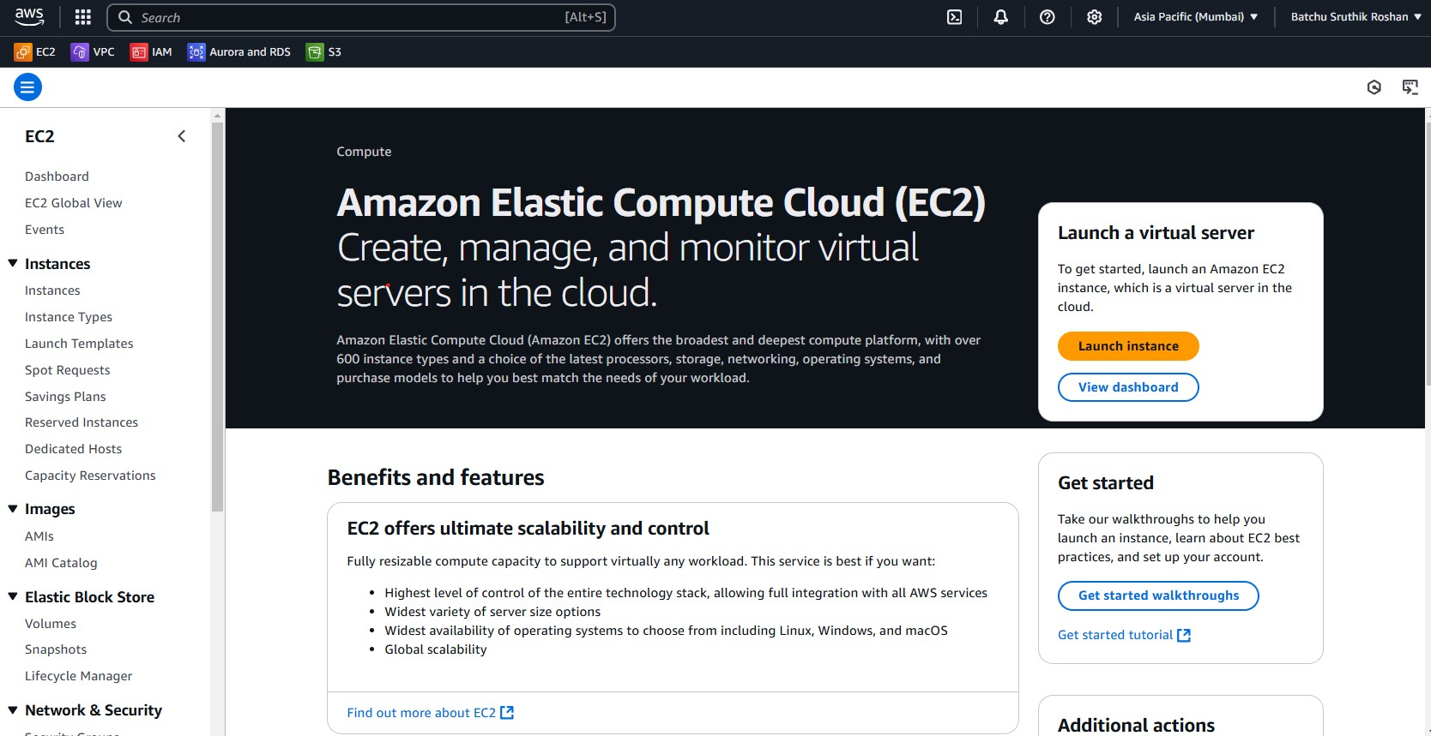
Step 3: Launch an Instance 1. Click Launch Instances.

Slide 5
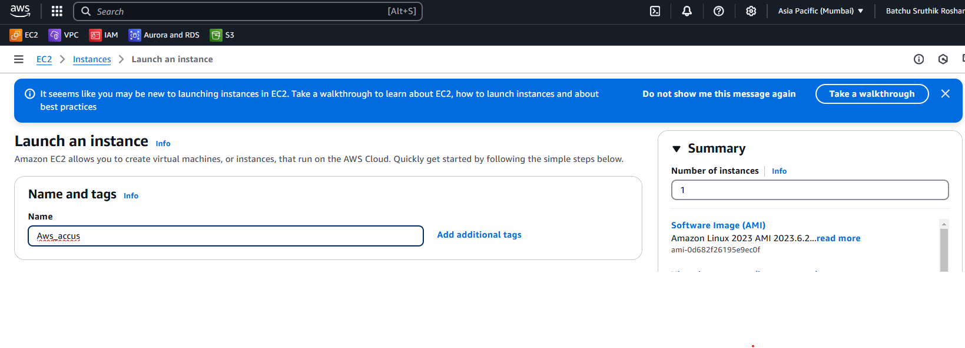
Step 4: Configure Instance Details 1. Name and Tags Provide a Name for your instance.

Slide 6
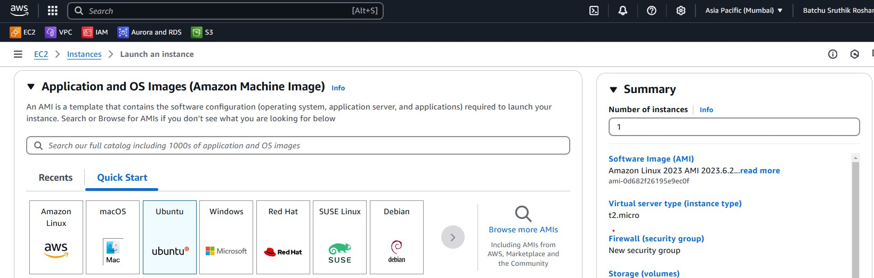
2. Choose Amazon Machine Image (AMI) Select an Amazon Machine Image (AMI), such as: Amazon Linux Ubuntu Windows Server Other custom AMIs (For example I am choosing ubuntu Ami)

Slide 7
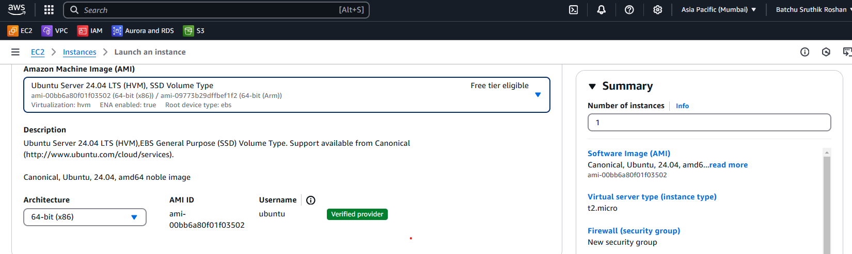

Slide 8
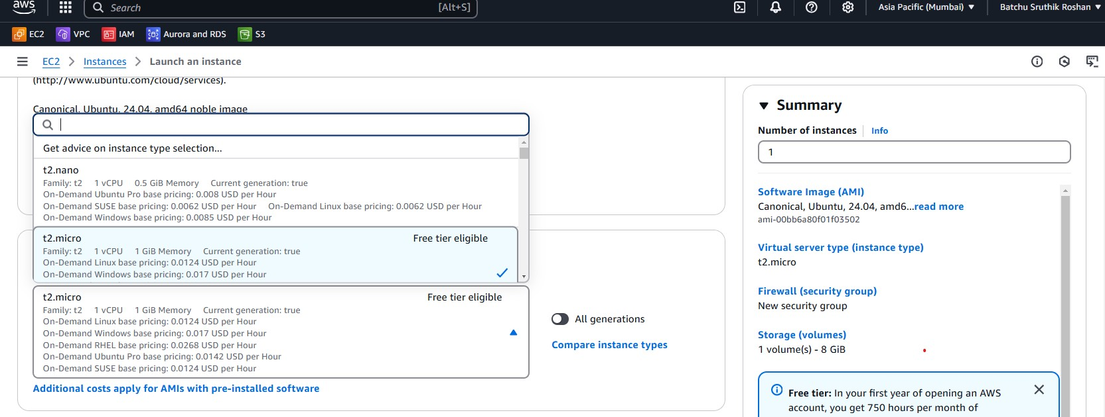
3. Choose Instance Type
Select an instance type based on your needs.
Example: t2.micro (free-tier eligible)

Slide 9
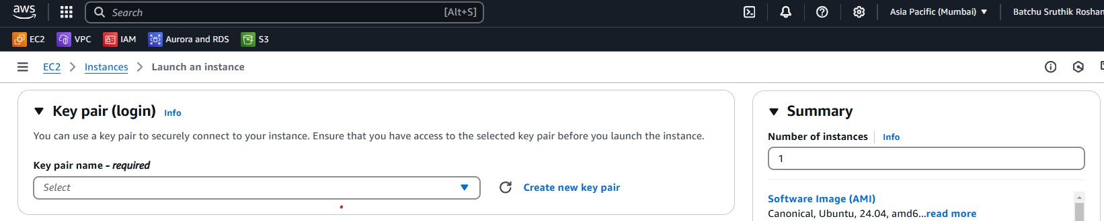
4. Configure Key Pair
If you have an existing Key Pair, select it.
If not, Create a New Key Pair, download the .pem file, and store it securely.

Slide 10
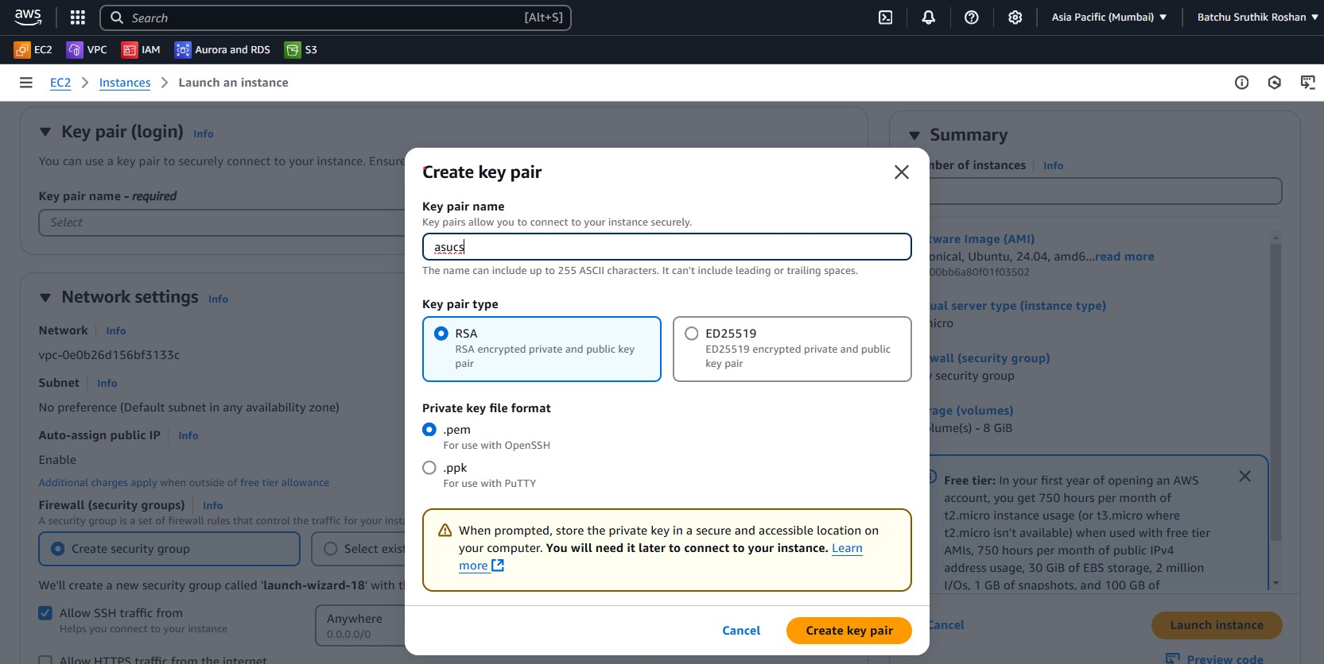

Slide 11
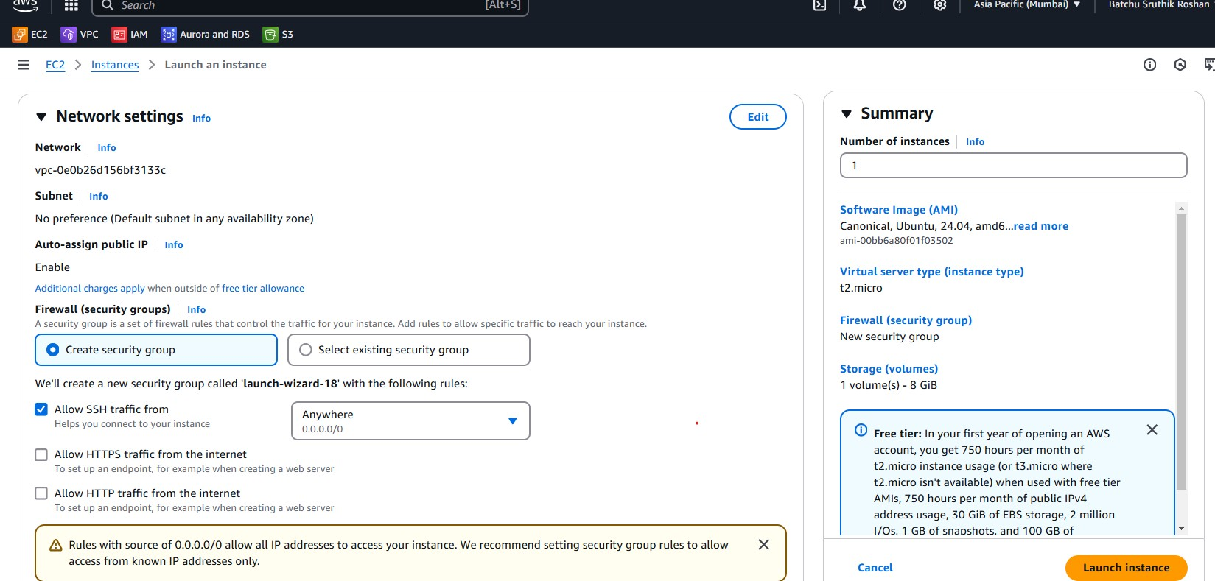
5. Configure Network Settings Select or create a VPC and Subnet. Enable Auto-assign Public IP (if needed). Configure security groups (open ports like SSH (22) for Linux, RDP (3389) for Windows).

Slide 12
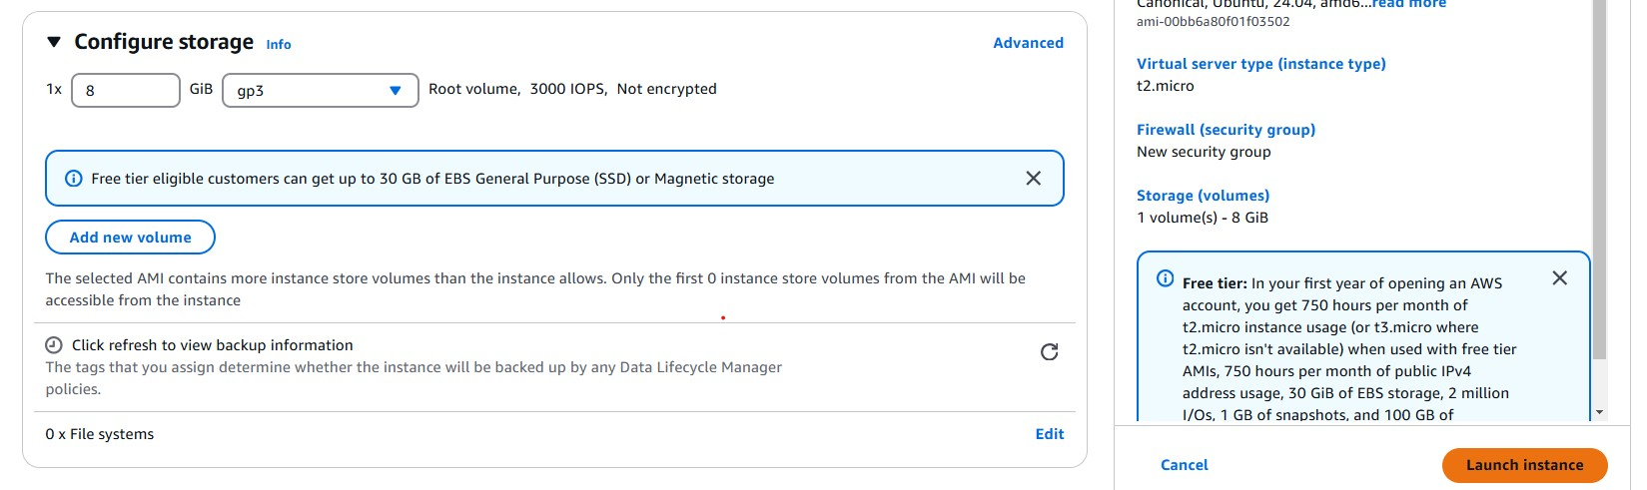
6. Configure Storage
Define the root volume size (e.g., 8GB for Linux, 30GB for Window)

Slide 13
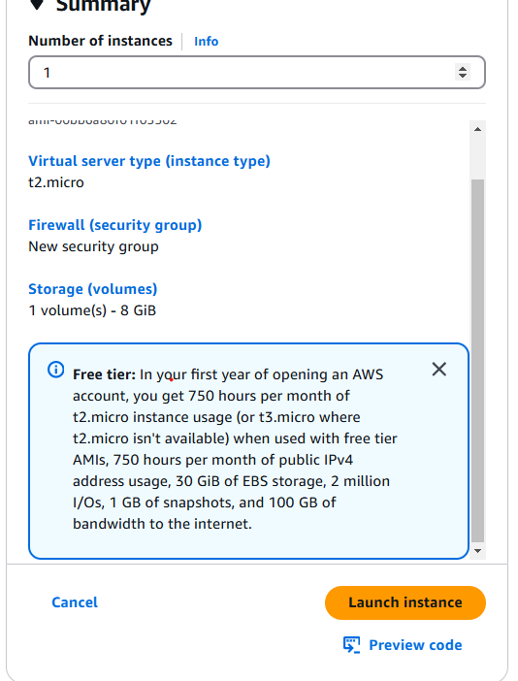
Step 5: Review and Launch Review all configurations. Click Launch Instance.

Slide 14
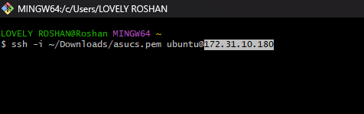
Step 6: Connect to Your Instance For Linux (Using SSH) Open a terminal and run

